Slide 1
VISINARY LEADERS
Batch-4 from Iot
presents:
challenging gender bias:
Strategies and promoting equality in daily life.

Slide 2
what is gender bias:
it is a prejudiced action or thoughts based on the gender- based perception that woman are not equal to men in rights and dignity.

Slide 3
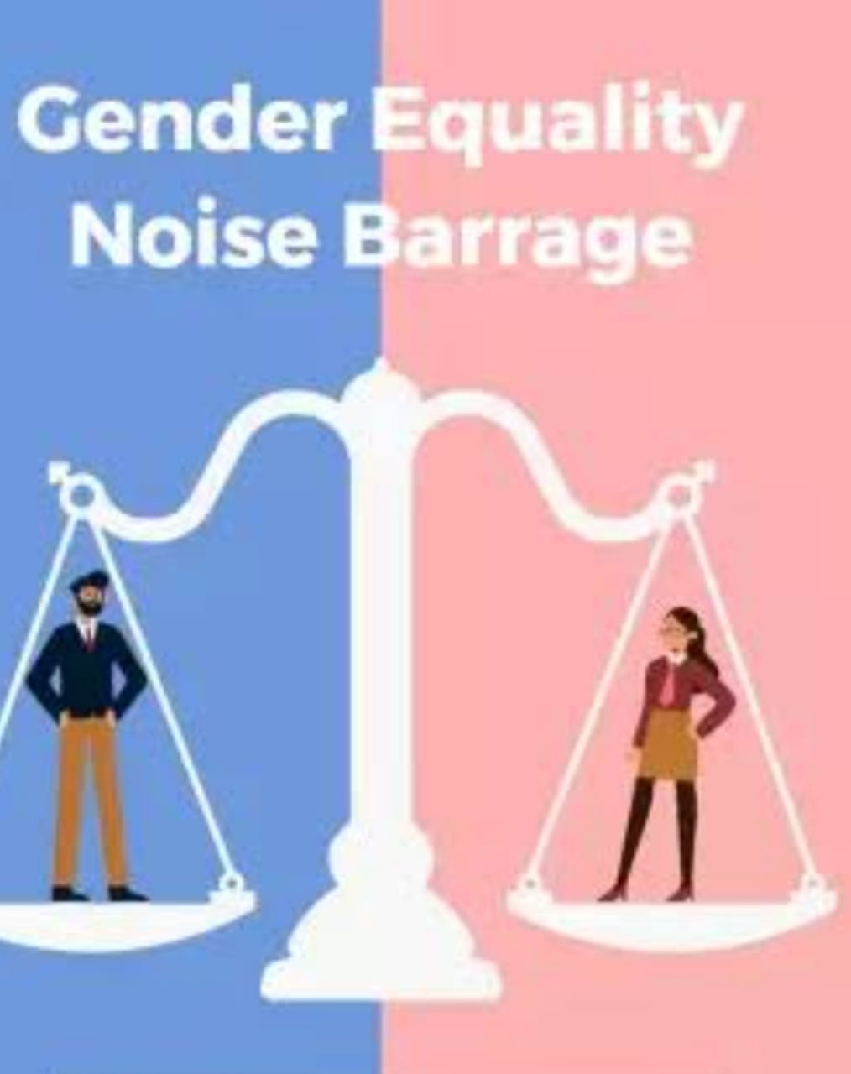
Promoting the gender equality:
Promoting equality and challenging gender bias in daily life requires intentional efforts and strategic actions.Here are some effective strategies to help create a more inclusive and equitable environment.
Some of the statergies are as follows:

Slide 4
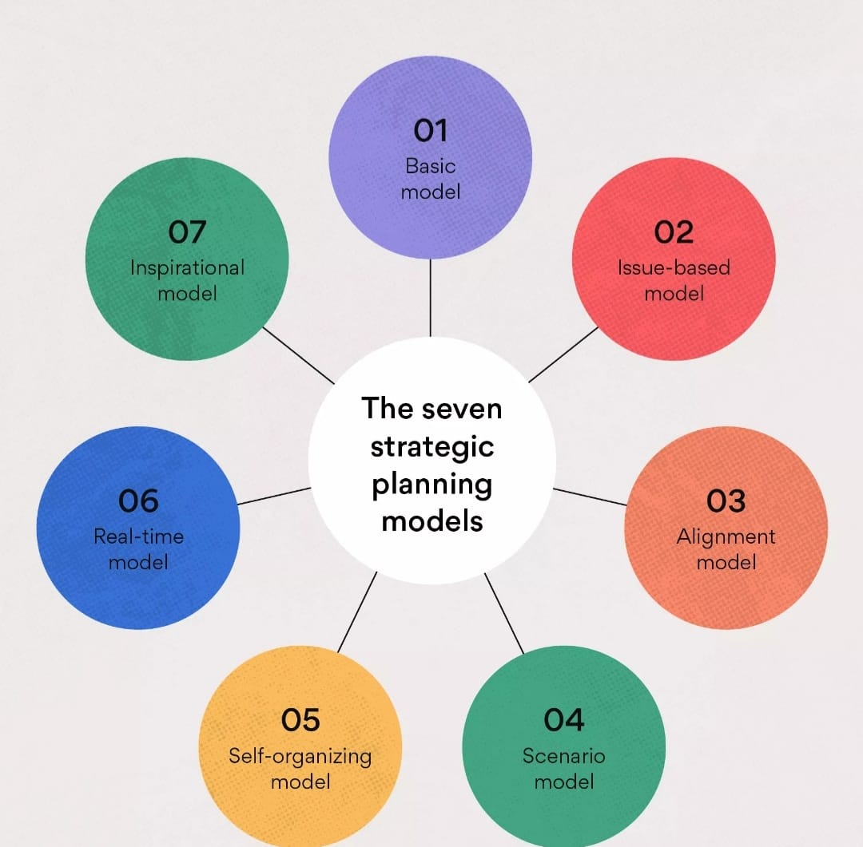
Personal startergies:
Self-reflection: Recogize and challenge your own biases.
Education: Learn about gender equality,feminisim,and intersectionality.
Language: Use inclusive language, avoid gendered terms.
Active Listening: Hear and amplify marginalized voices.

Slide 5
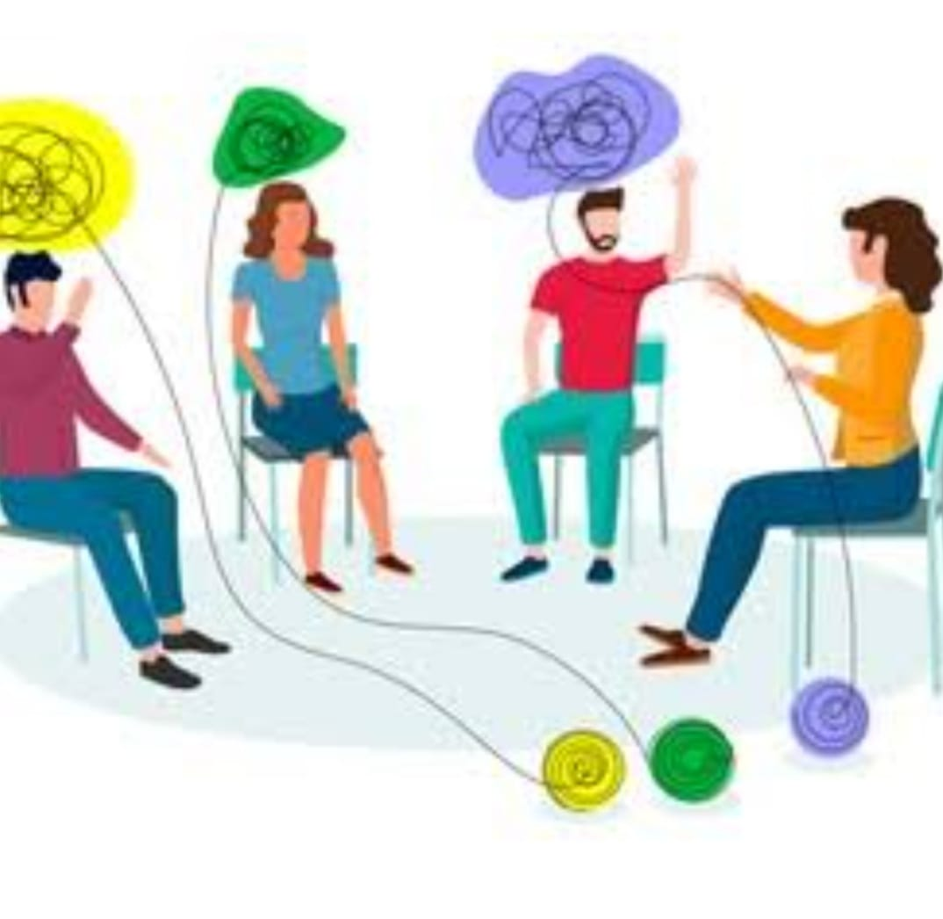
Interpersonal strategies:
Speak up: challenge sexist comments,jokes.
Support marginalized groups:Be an ally.
Encourage diversity:Promote inclusive social circles.
Respect bounderies:Prioritize content.

Slide 6
COMMUNITY STRATEGIES:
Inclusive hiring: Ensure fair representation.
Gender-neutral policies: Implement flexible parental leave.
Training: provide diversity,inclusion workshops,seminars.
Volunteers: Support organisation promoting gender equality.

